Slide 1
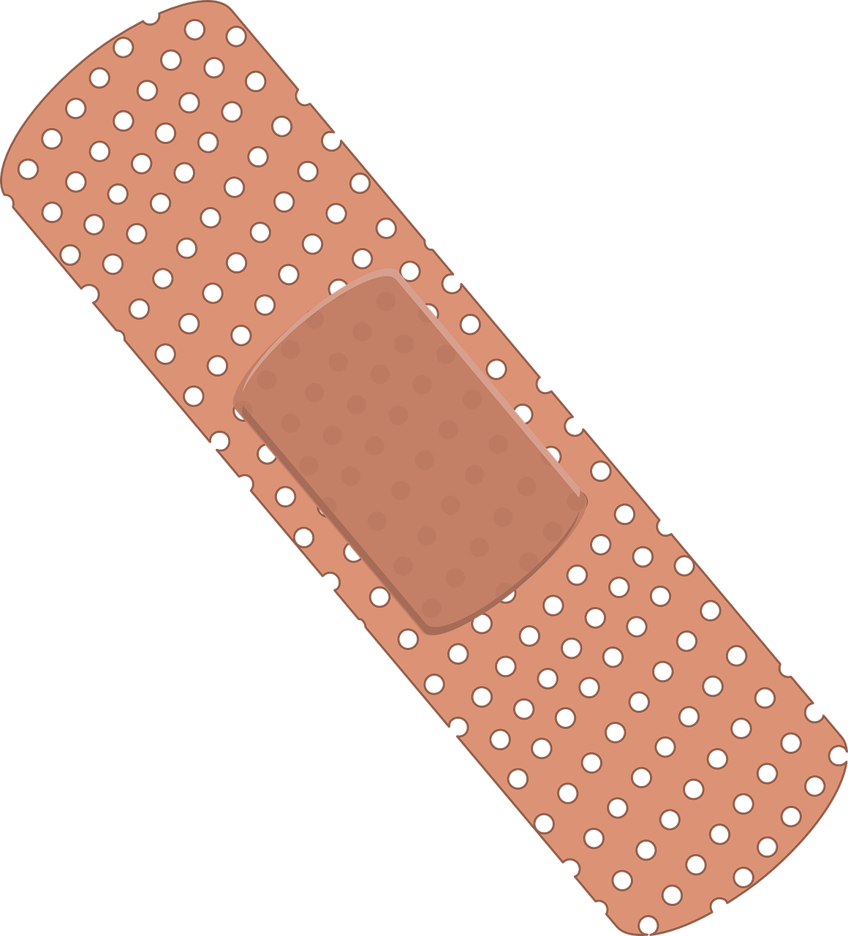
MIMIC-IV ECG Dataset
Improving neural network accuracy for cardiac condition diagnosis.

Slide 2
Table of contents
01 Overview
ECG
MIMIC-IV
02 Methodology
Tools
Technique
03 Findings & Conclusions
Graphs
More Graphs

Slide 3
01
Overview

Slide 4
Overview - ECG
An ECG (Electrocardiogram) is a medical test that records the heart's electrical activity.
ECG provides a graphical representation of the heart's rhythms.
ECG is used for diagnosing and monitoring various heart conditions.
ECGs are a fundamental tool in cardiology and healthcare.

Slide 5
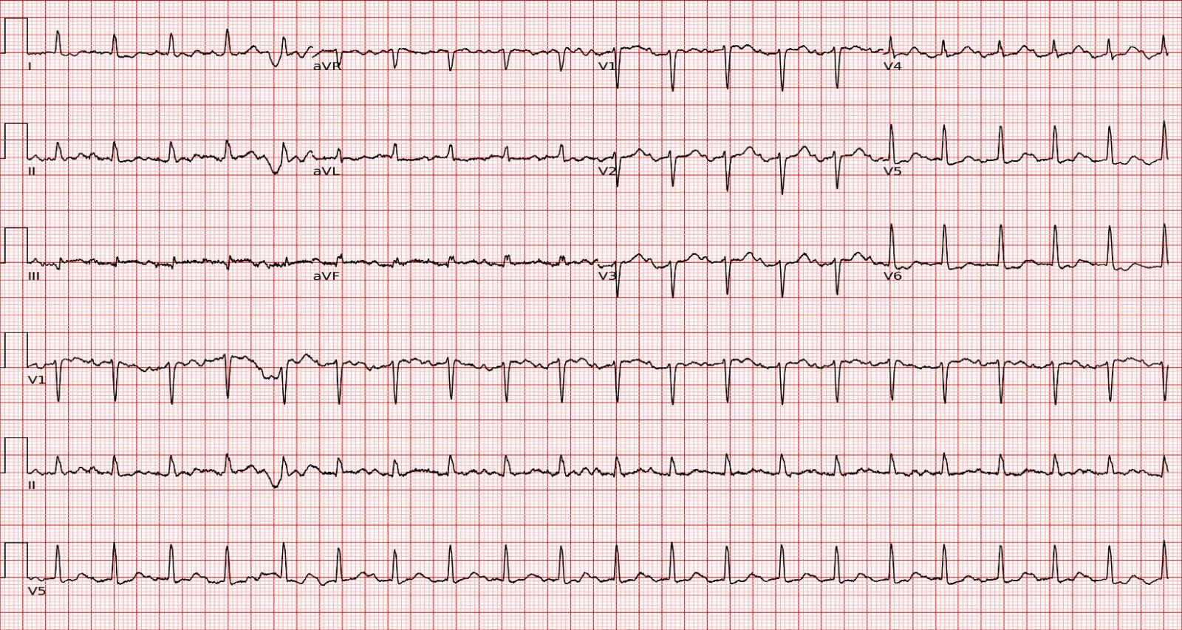
Overview - ECG
12 leads 10 seconds in length.
Sampled at a rate of 500 Hz.

Slide 6
Overview - MIMIC-IV
MIMIC-IV is a publicly available database of electronic health records from intensive care units.
MIMIC-IV ECG dataset contains numerous monitorings of patients’ heart's electrical activity.

Slide 7
MIMIC-IV
In numbers:
800,035 diagnostic electrocardiograms!
159,608 patients!
90 GBs of raw data!
320 GBs of rendered images!
5 ecgs per patient
on average

Slide 8
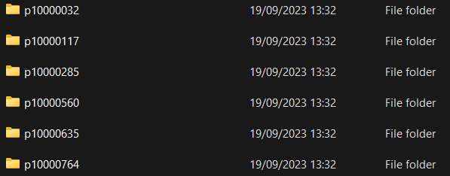


MIMIC-IV data
s40689238 is the study number
Random number
P10000032 is a unique patient number

Slide 9
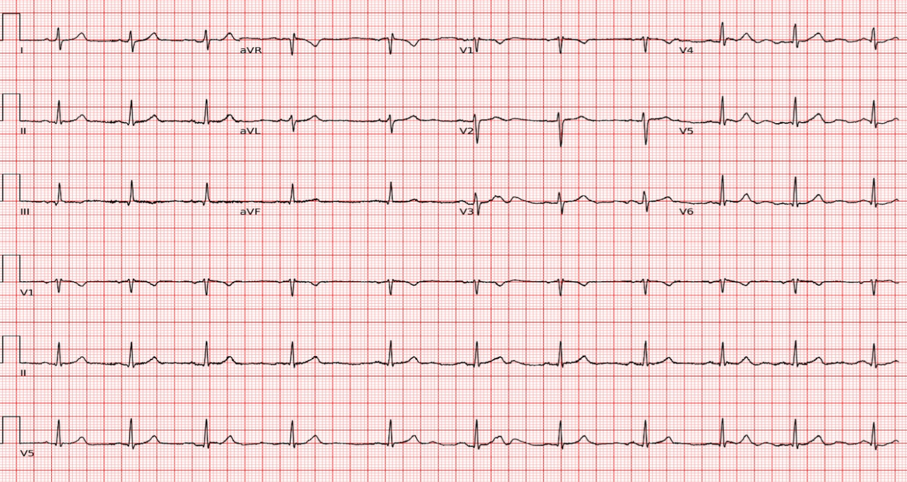
A Unique image_id is born:
patient_id_study_id.png
10000560_41445586.png

Slide 10
02
Methodology

Slide 11
Methodology - Tools
Python
Google Sheets
Manual diagnoses matching: accelerated by using Regex
Boosting team collaboration
Data analysis using Pandas
String matching using Fuzzy
Live-code execution using Jupyter

Slide 12
Methodology - Technique
First try - matching free text diagnosis to categories
Apply ‘Fuzzy’, a string matching tool to categorize free-text diagnostic descriptions into predefined categories.

Slide 13
Fuzzy, step by step
Step 1
Step 2
Step 3
Step 4
Set predefined categories
Apply Fuzzy on a free text diagnosis description. Get scores.
The category with the highest score is probably the described diagnosis
Fail.

Slide 14

Fuzzy, shortcomings
Abbreviations:
Shortcuts:
Observations, not diagnosis:
General nonsense:
Low accuracy.

Slide 15
Unique reports set
Remove the excess
Manual matching
Second try
manual string matching
Create a duplicates-free set with all of the reports
Remove all useless prefixes and suffixes
Using Regex and text-editing tools
Verified twice

Slide 16
In numbers:
4.12
diagnosis per ECG image
on average
3,088 unique reports.
259 predefined categories.
Goal: match 3088 free text diagnosis descriptions using 259 categories.

Slide 17
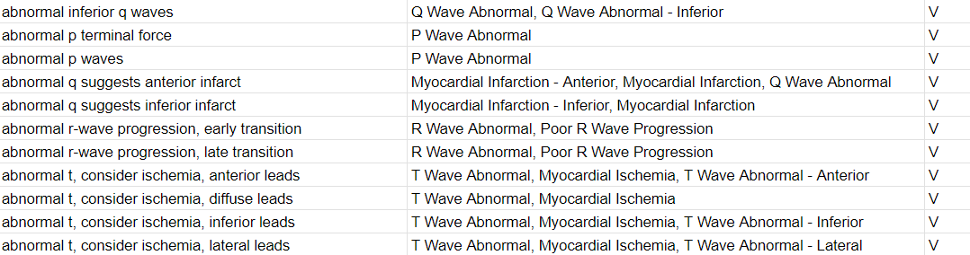
Manual string match
free-text diagnosis
categories
verification

Slide 18
03
Findings & Conclusions

Slide 19
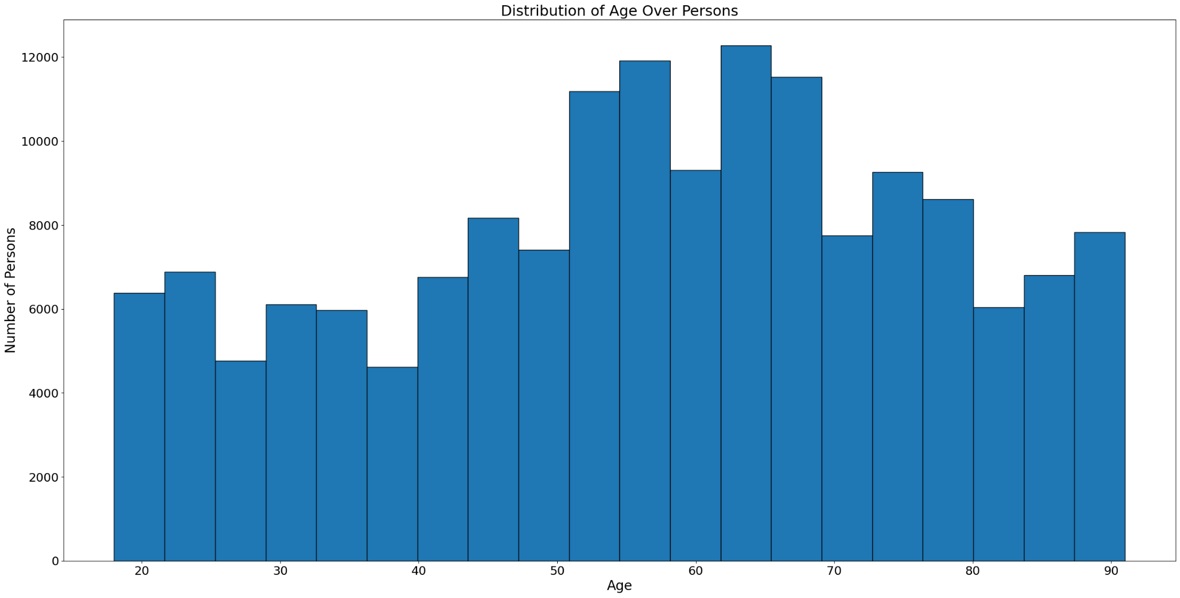
Age distribution

Slide 20
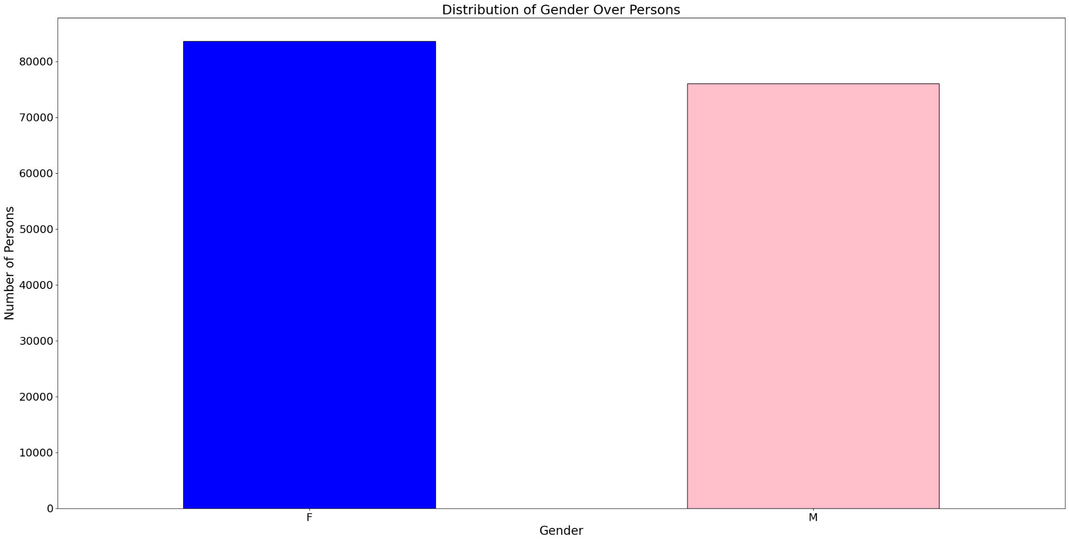
Gender distribution

Slide 21
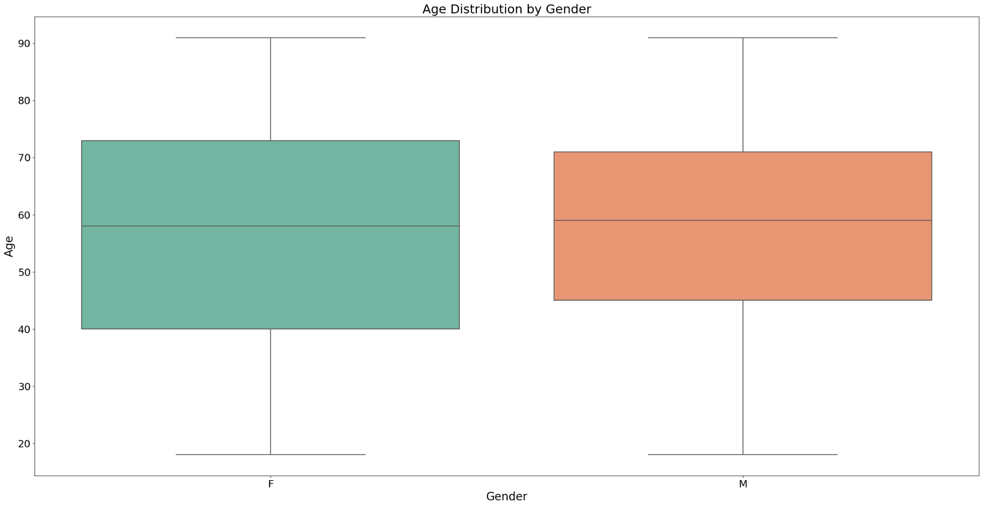
Gender and Age, Median

Slide 22


Conclusions & Findings
76,011 male patients
Male median age 59.0
83,597 female patients
Female median age 58.0

Slide 23
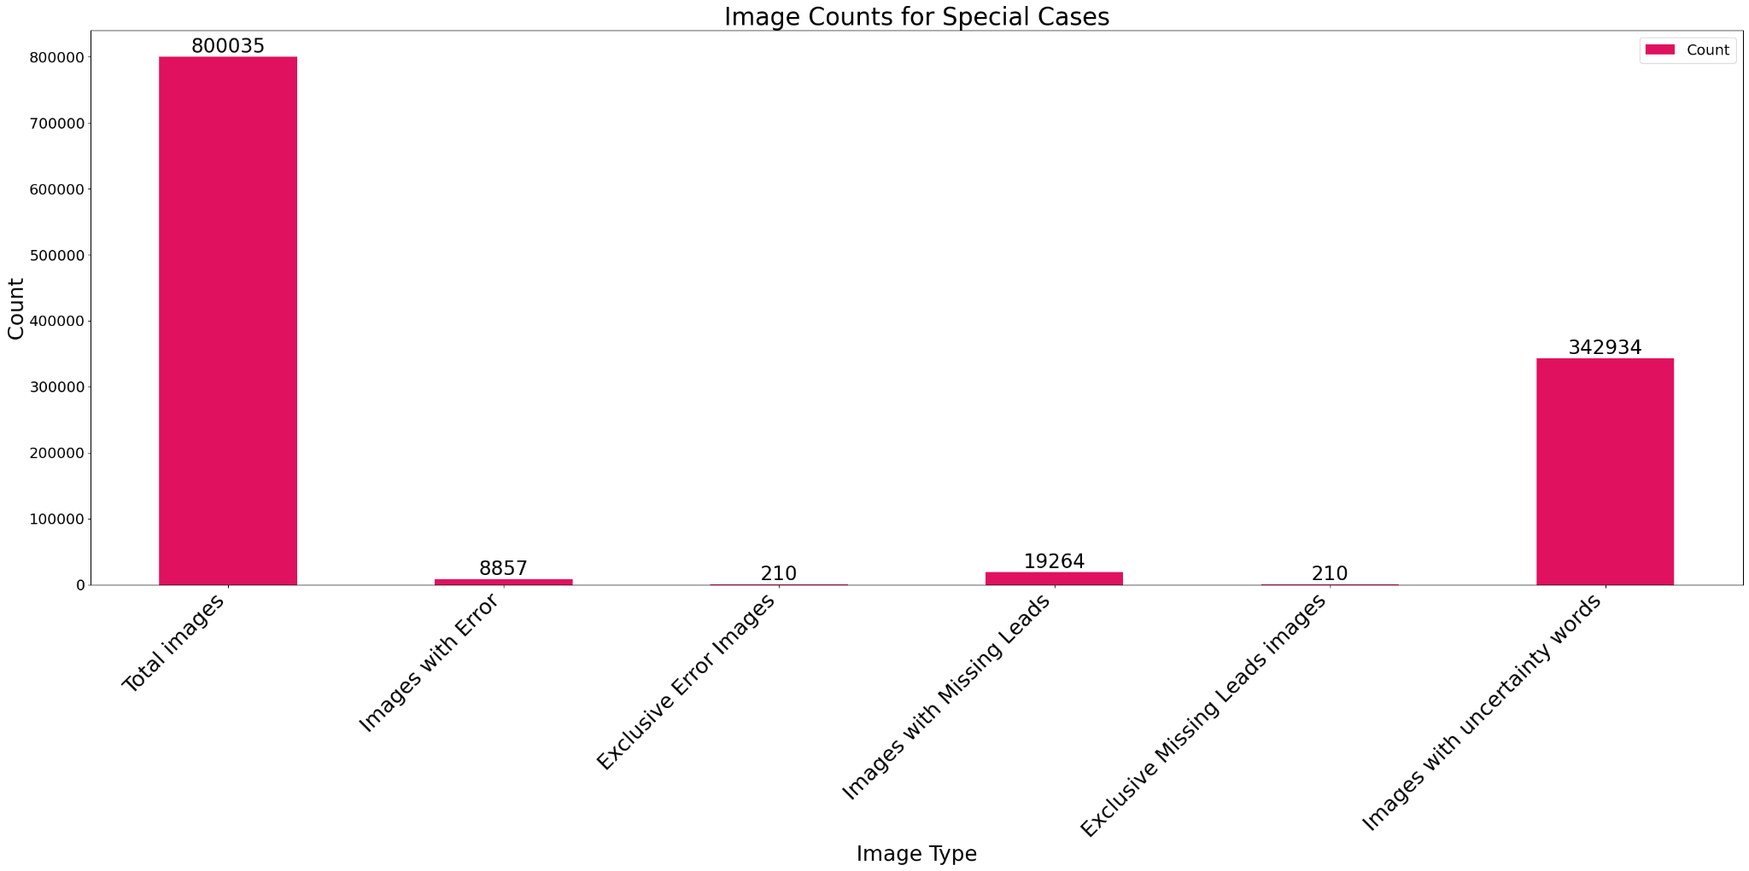
Special cases (Exclusive)

Slide 24
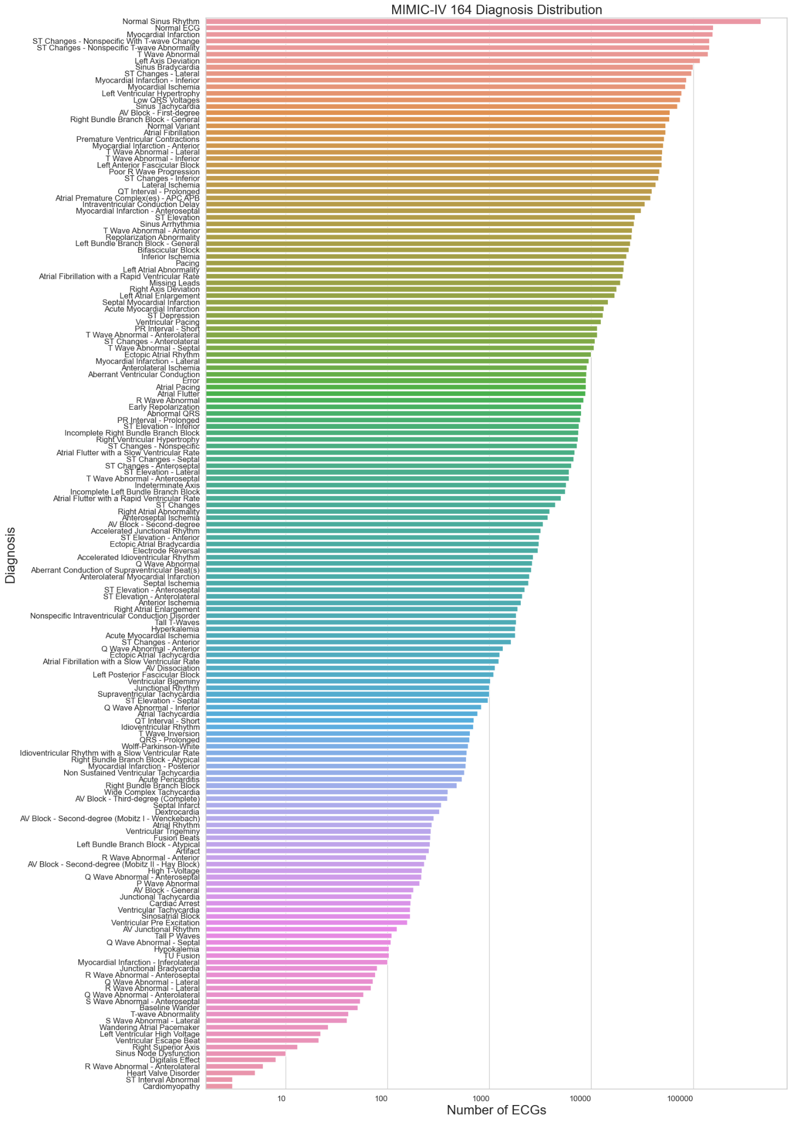
Total of 164 Categories distribution
3,300,613 categories matched.
4.12
diagnosis per ECG image
on average
(logarithmic scale)

Slide 25
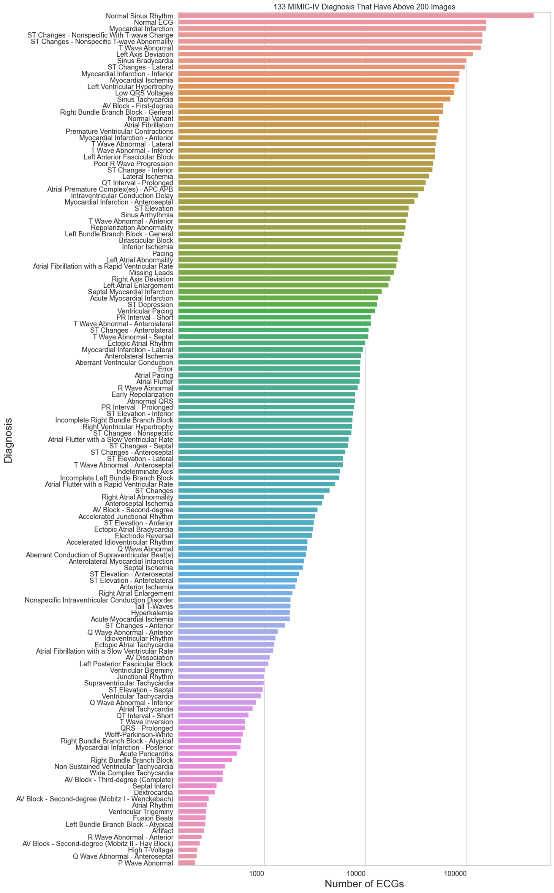
133 categories with over 200 rendered images
(logarithmic scale)

Slide 26
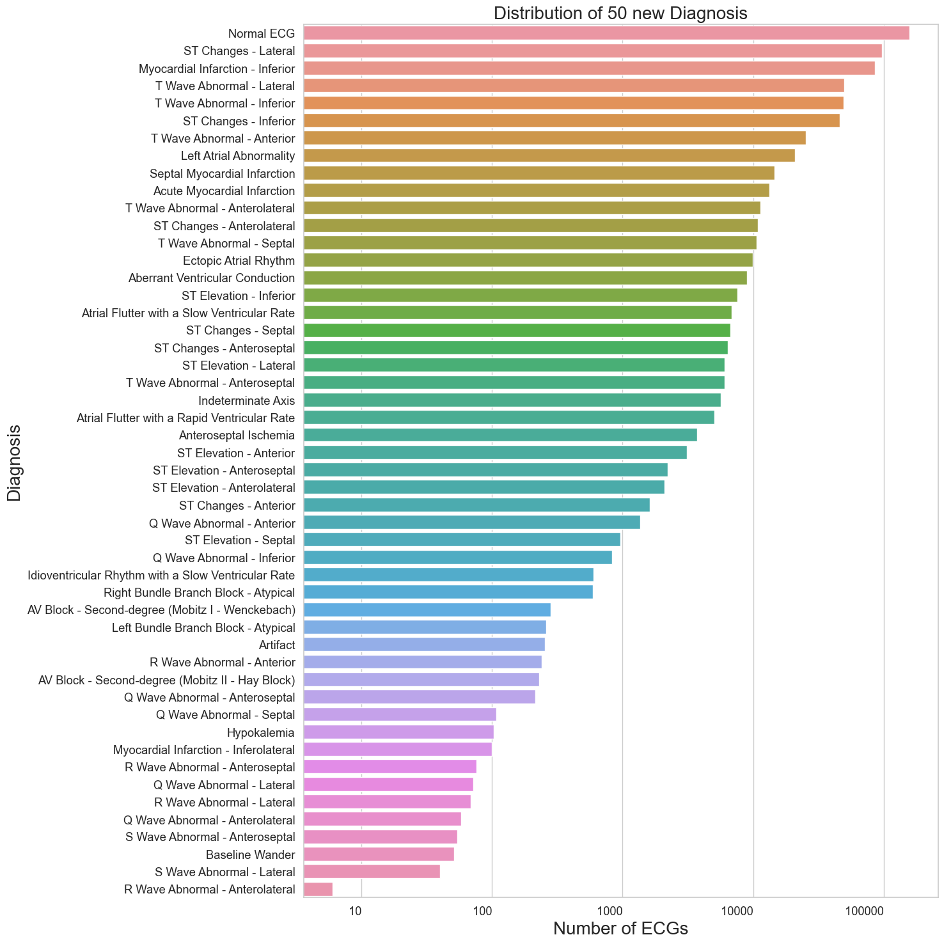
New categories & subcategories distribution
(logarithmic scale)

Slide 27
Conclusions
76 new categories added during the project (259 in total)
New subcategories, higher resolution:
Inferior
Anterior
Lateral
Inferolateral
Anterolateral
Posterior
Septal
Anteroseptal
Changes documented in categories_keys.py
ST Elevation - Anterolateral
ST Changes - Inferior
S Wave Abnormal - Lateral
T Wave Abnormal - Lateral
R Wave Abnormal - Anteroseptal
Q Wave Abnormal - Septal

Slide 28


SPECIAL THANKS
THE TEAM
Vadim Gliner, for assisting us for with medical information
Idan Levy, for guiding us in the right direction
Dani Babchik
Itay Lael
CS, Technion
CS, Technion

Slide 29
Icon pack

